Slide 1
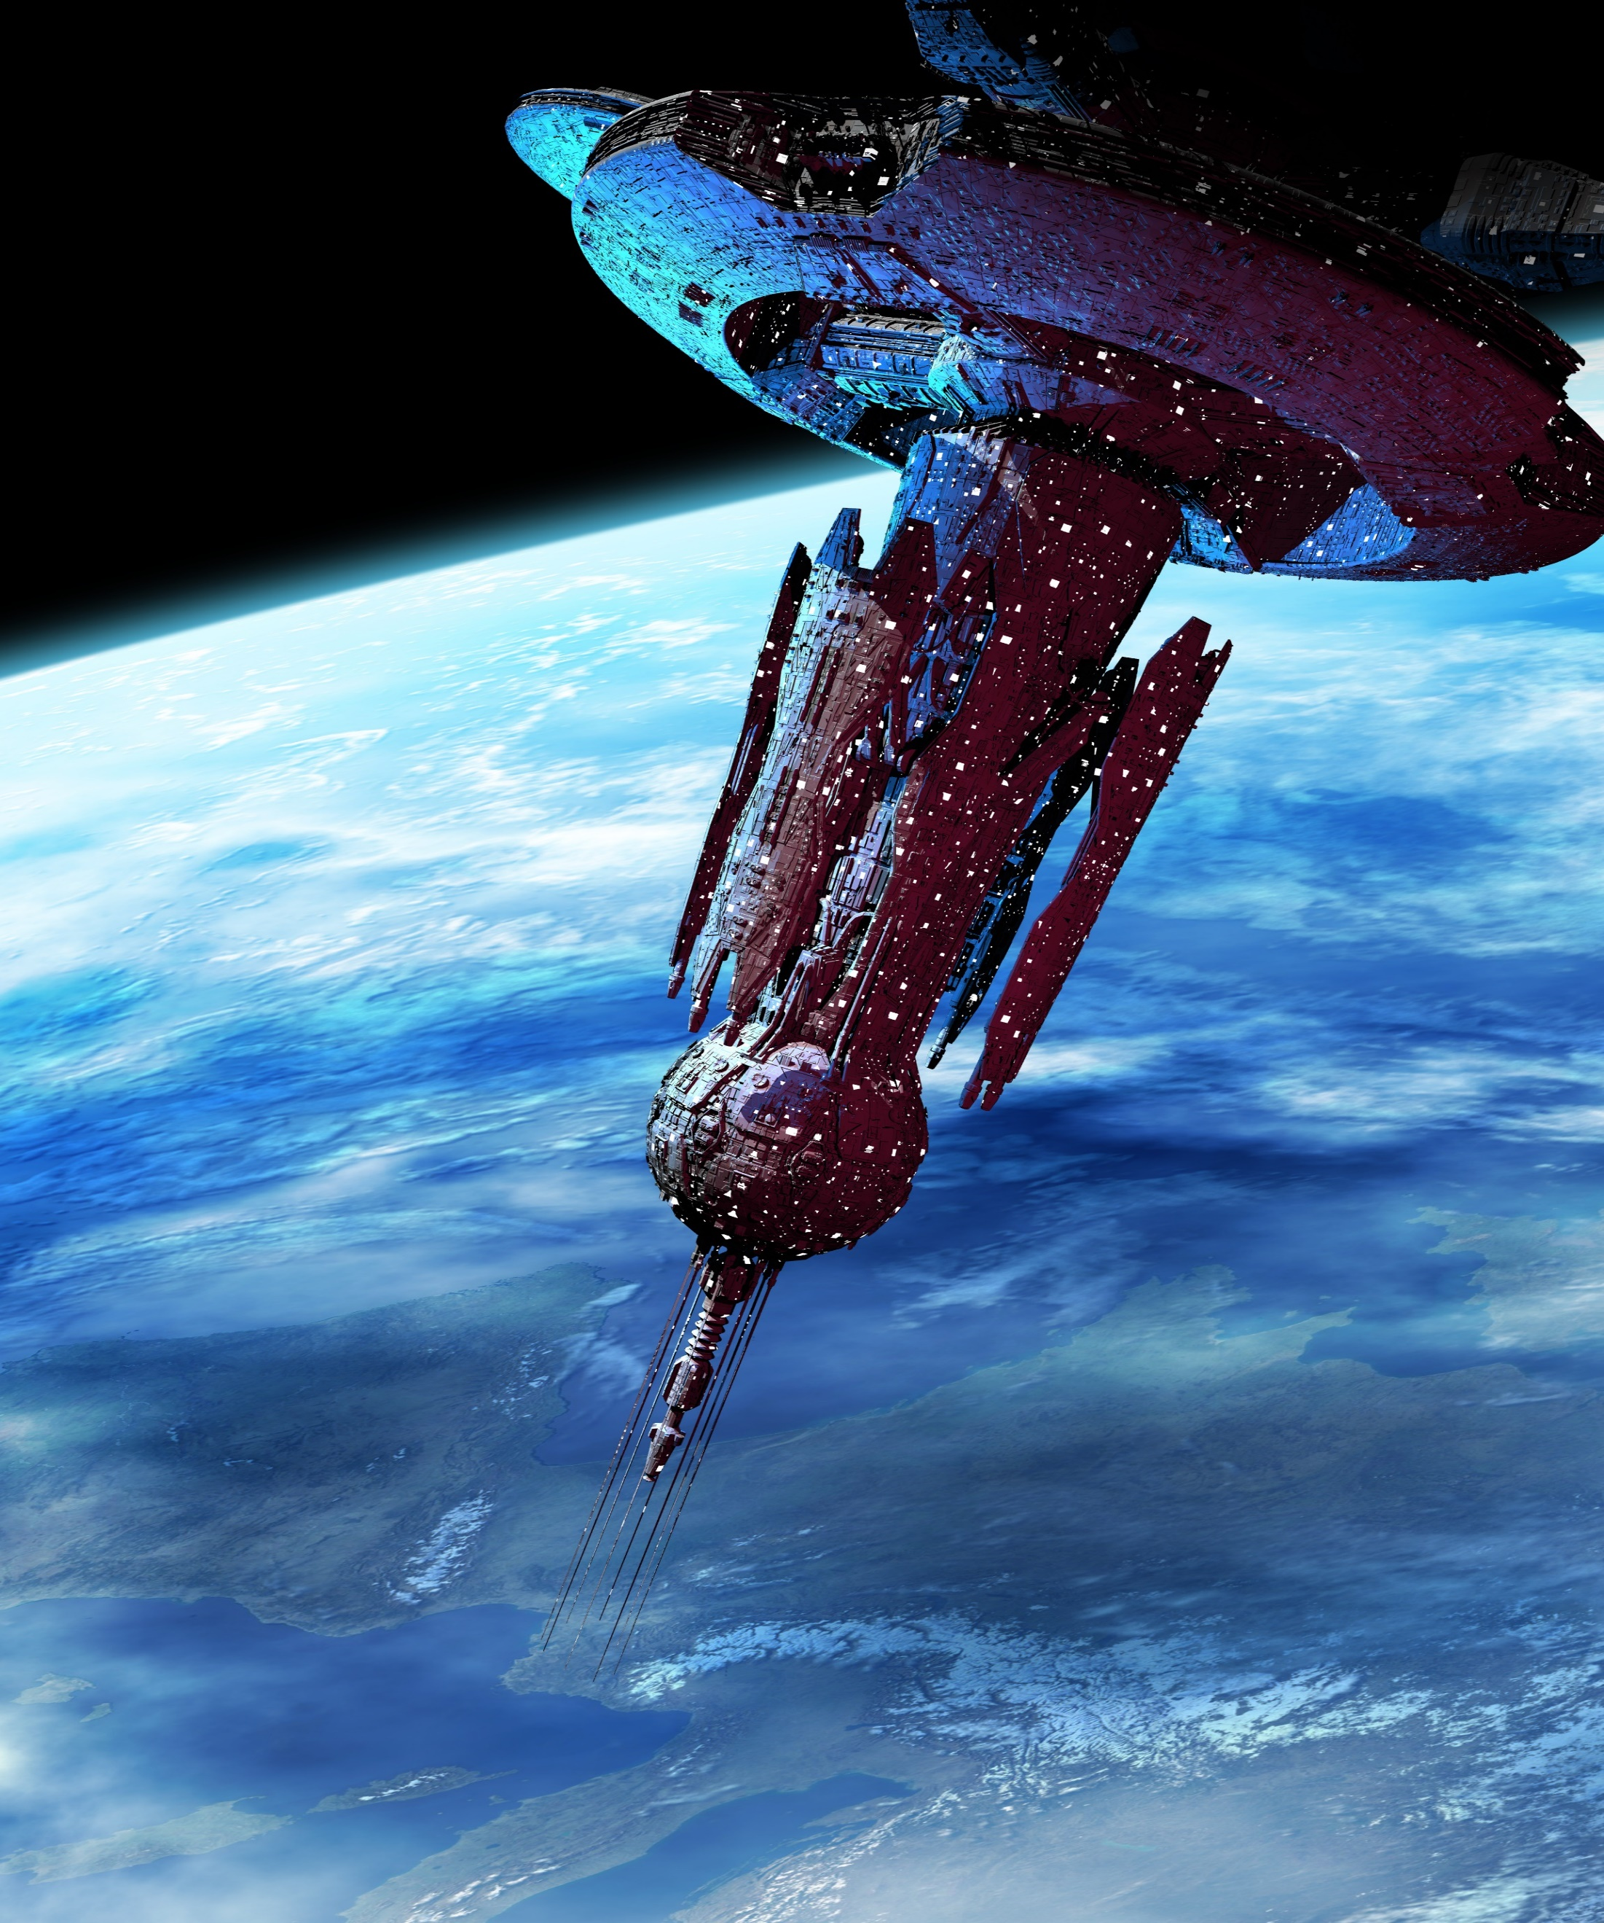
Northern Transport Intergalactic Corporation
Majesty of the Stars
Overview Press Kit

Slide 2
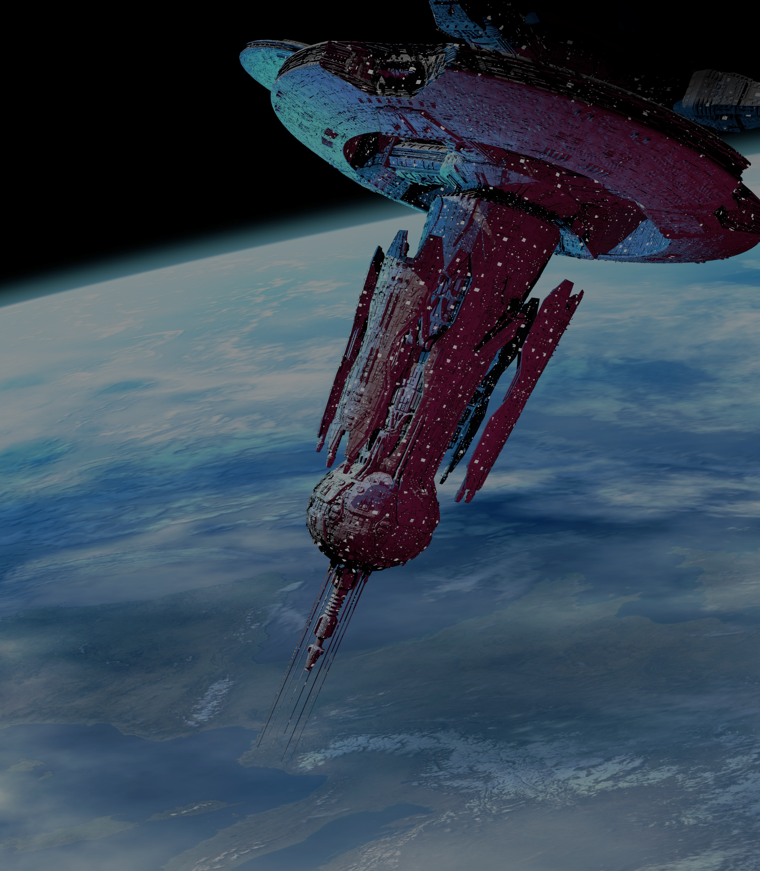
Majesty of the Stars is the flagship of the Northern Transport Intergalactic Corporation. The construction of this engineering masterpiece is the result of decades of technological advancement. This luxurious yet functional spacecraft offers a multitude of amenities and opportunities for family vacationers, business interests and research scientists.
The Majesty of the Stars is more of a moving city rather than a method of transportation. 50,000 people at any one time can travel aboard this phenomenon in complete comfort. The state rooms, from the studio suites to the penthouse apartments are professionally appointed and provide all the luxuries of a well-appointed home in a contemporary city.
Among other features available to all guests are the following:
  5 movie theaters
  3 concert venues with up to 20,000 seats
  27 establishments from quaint bistros and nightclubs to renowned gourmet restaurants
  A 150 acre lake that accommodates skiing and sailing
  A theme park with near zero gravity sky diving and 7 rollercoasters
  Business space for individuals and complete companies
  Communication accessibility to Earth and all outposts
“The Majesty of the Stars was a dream assignment after a long 40 year career. This is truly a pinnacle of human accomplishment. When I was asked to pilot this great vessel, I did not hesitate to accept the honor. Those who travel with us are welcomed and treated with the utmost attention to all details. Experience this opportunity and live the dream with me. Please accept my welcome aboard.”
Captain Stin Brogrick

Slide 3


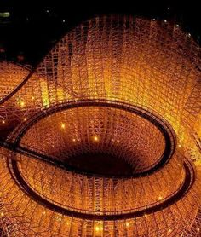
The Majesty of the Stars provides a full experience for anyone looking to escape the pressures of daily life or to live a grand exploration. The various vacation packages offer a variety of choices, depending on length of stay and desired activities. Whatever your recreational desire, the array of activities is nearly endless.
Try Parasailing across Lake Majestic, followed by a night time sail under the biggest sky you will ever see.
The amusement park beckons with 45 different rides. Many were designed especially for the Majesty of the Stars to take advantage of the micro-gravity environment. Especially unique is the famous zero-gravity water park featuring a 200 foot five minute free fall into the lake.

Slide 4
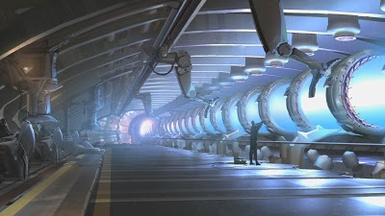
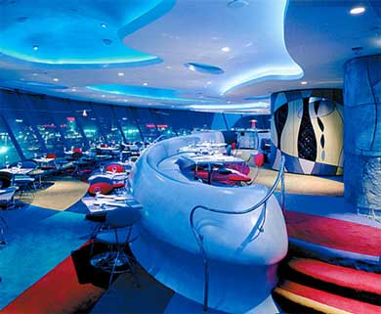
Participate in many of the group activities and classes.
Explore the Majesty of the Stars as described in David George Howard's thriller novel Identity. Take an interactive visual and audio tour around the ship to follow the action.
Dine at one of the many themed restaurants that offer a wide variety of award winning dishes.
Enjoy the daily and nightly music and dance shows throughout the entertainment complex.

Slide 5
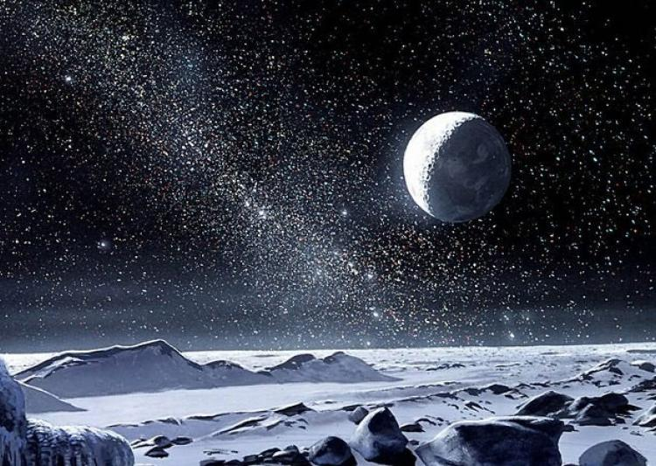
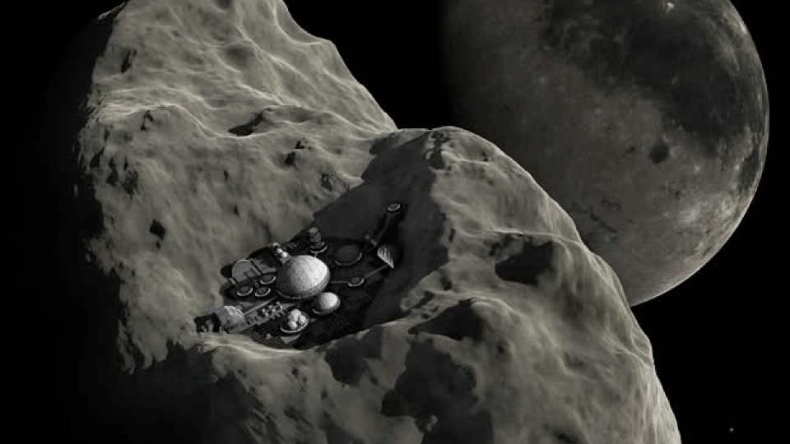
The Majesty of the Stars provides a gateway to adventures unheard of just a few years ago. The sky is literally not the limit to adventures beyond your imagination. Frequent shuttles take groups of people to various destinations that will fill your senses with awe-inspiring wonder.
Have you ever skied down a 20,000 foot frozen methane covered mountain? It is a rare experience. The Majesty of the Stars provides access to the recently opened slopes on Pluto. Outfitted in the latest pressure suit and frozen air breathing apparatus, you will have up to 12 hours of slope time in this frozen wilderness. Accommodations on the planet are also available for a longer stay.
If you are more inclined to hike, try asteroid hopping. For this, the adventurer wears a light propellant pack and explores the asteroid fields in the solar system. Group tours of 5 to 20 people set out to climb and float between these celestial wonders. Solar sailing is available for those inclined. Experience the thrill of riding and racing around the cliffs and outcroppings of these once unreachable locations.

Slide 6
The Majesty of the Stars in not solely designed for pleasure cruising. The platform was developed to provide business space for the companies that can seize the opportunity. From the person who needs to stay in touch with the home office, to land development companies, to research laboratories, to international conglomerates, the Majesty of the Stars can accommodate.
Access
Majesty of the Stars has the latest and fastest data transmission capabilities, across all civilian bandwidths. This provides each business user the opportunity to stay in contact with all the necessary interests. Audio and visual communication is minimally delayed such that real time meetings can be held while in transit, rather than through exported data packages. This technology is supported by a staff of 100 engineers and technicians on hand at all times to help with your data needs.
Location
Majesty of the Stars provides an unparalleled outpost for your business. Imagine the time savings by having a staff ready to deploy at a moment's notice and able to reach remote locations in a few days rather than weeks. Businesses specializing in land, resources, entertainment, transportation, and business services are but a few that would benefit from this type of advantage.

Slide 7
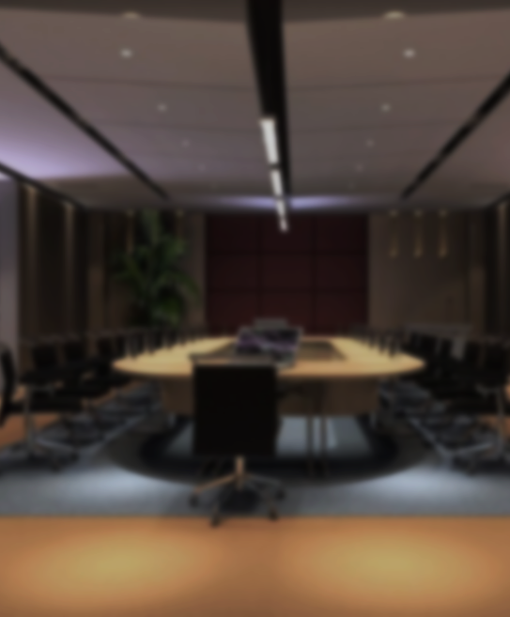
Office space for lease or purchase can be configured to your wishes. Conference rooms seating 5 to 500 are available. Hold your next convention here for maximum exposure and participation. Catering services are available for parties of all sizes.
Majesty of the Stars operates as its own legal jurisdiction. In matters that require formal proceedings, provisions are provided to conduct hearings and trials remotely. The decisions are as legally binding as any court of law.
On-site presence
Majesty of the Stars has 41 businesses with a permanent presence on-board. For these organizations, they have realized the potential for this unique type of access. These businesses include:
Legal Services
Financial Services
Engineering and Construction
Entertainment and food providers
One particular example of establishing a mobile base of operations is Gravaton Inc. Gravaton provides manufacturing and laboratory capabilities both for those aboard and at remote locations.
“When we set up the laboratories, shops and office space, we anticipated a small steady business. The internally controlled climate allows us to provide specialized test chambers, with and without gravity, magnetic influences or air; all close to our customers. Our one-of-a-kind mobile carbon nano-tube parts production, plus ceramic and metallic plating operations, are unmatched by any of our competitors. In the past two years we have had to triple our size. This could not have been done without this kind of spacecraft.”
  Gert Vanderher, President of Off-Earth Operations, Gravaton

Slide 8

The following companies are only a few that have a continued presence on the Majesty of the Stars
Royal
Bert
Butt
ton
rum
ress
Royalton, Bertrum and Buttress, Corporate Legal counsel. "Litigation, intellectual property, labor and employment, white collar crime. If you did it we can help.“
Ven Sckranker, Personal Injury Attorney. "Your Pain and my Claim is your Gain.
VS Law
Of course, your employees will enjoy working in an environment that offers so much during off-time hours. All of the amenities available to the leisure consumer are accessible to those living on-board permanently. The Majesty of the Stars is more than a place to play.
It is a place to work, live, grow and thrive.
Proctor Dental Group. "Your Dentist in the Stars!“
Proctor
DIGGUM
Diggum Global, Banking and Financial Services. "No matter where you are, and where you travel, we are watching you.“
Blinker
Blinker Design. Interior Architects. "A chair, stair and flair where? There!“
Design

Slide 9

Majesty of the Stars
The adventure of a lifetime
A lifetime of adventure
Your universe awaits
Northern Transport Intergalactic Corporation

